Slide 1
Study Design
CS3300 Data Science

Slide 2
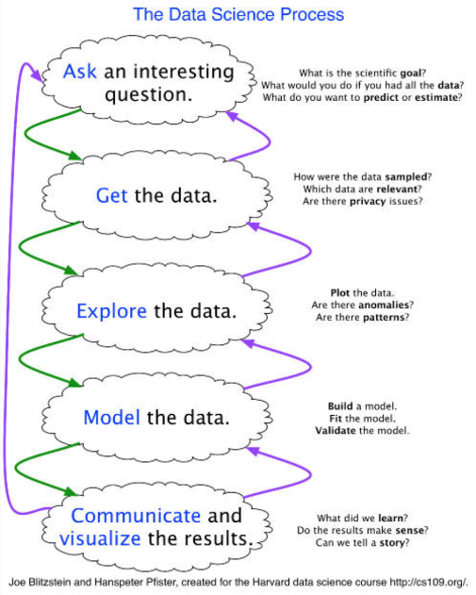
Data Science Process

Slide 3
Modes of Inquiry: Data Driven
We start with a data set
We explore the data set to identify patterns
From these patterns, we ask questions and form hypotheses
We may be able to use the data to answer the hypothesis or may need to design a new experiment
This is a new mode of inquiry and what makes Data Science different from traditional science and engineering.

Slide 4
Modes of Inquiry: Hypothesis Driven
Traditional scientific method
We form a hypothesis
We design an experiment (including collecting data) to test the hypothesis
If the experiment is able to reject or disprove the hypothesis, we generate a new hypothesis
Otherwise, we design another experiment to test the hypothesis
Eventually, if we are unable to disprove the hypothesis, it becomes a law

Slide 5
Study Design
In some cases, you may have an opportunity to participate in the design of a study
Process
State Research Questions and Hypotheses
Identify Data Sources and How Much Data to Collect
Evaluate Feasibility & Sustainability of Study
Evaluate Security of Study
Evaluate Ethics of Study

Slide 6
Research Questions
Before collecting data, we should identify research questions and hypotheses
Good research questions are:
Clear: it provides enough specifics that one’s audience can easily understand its purpose without needing additional explanation
Focused: it is narrow enough that it can be answered thoroughly
Concise: it is expressed in the fewest possible words
Specific: explicitly identify variables of interest and their relationship
https://writingcenter.gmu.edu/guides/how-to-write-a-research-question

Slide 7
Research Questions
Good
Bad
How does the education level of the parent impact childhood obesity rates in Phoenix, AZ?
How does childhood obesity correlate with academic performance in elementary school children?
What is the relationship between physical activity levels and childhood obesity?
What is the childhood obesity rate in Phoenix, AZ?
What are the effects of childhood obesity in the United States?
How much time do young children spend doing physical activity per day?
https://cirt.gcu.edu/research/developmentresources/tutorials/question

Slide 8
Hypotheses
"Educated guess" that answers a research question
We should seek to prove or disprove the hypothesis
Well-constructed hypothesis:
Is a statement in an "if-then" form
Specific (mentions variables and the direction of their relationship)
Testable (falsifiable)
Hypotheses are not questions, they are statements
https://www.sciencebuddies.org/blog/a-strong-hypothesis

Slide 9
Hypotheses
Good Hypotheses
Bad Hypotheses
When there is less oxygen in the water, rainbow trout suffer more lice.
Aphid-infected plants that are exposed to ladybugs will have fewer aphids after a week than aphid-infected plants which are left untreated.
Our universe is surrounded by another, larger universe, with which we can have absolutely no contact.
Ladybugs are a good natural pesticide for treating aphid infected plants.

Slide 10
Study Types
Observational Studies
Controlled Experiments
Investigators observe subjects and measure variables of interest
Without assigning treatments to the subjects
Data is collected without changing the system being observed
Independent and dependent variables are identified
Apply treatments to experimental units (alter independent variables)
Observe changes in dependent variables

Slide 11
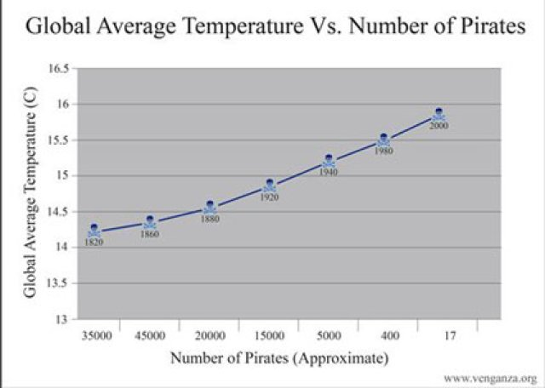
Correlation does not imply Causation
Very popular to say.
True - but cool it.
Why controlled studies are great
Try to control confounding variables

Slide 12
What and How Much Data
Using statistics, we can figure out how many data points we need to collect to support a hypothesis
This depends on:
Effect size: How large are the differences for a measured variable between two groups?
Desired level of confidence: 95%? 90%?
A smaller effect size requires more data to detect
This is usually not feasible for machine learning models that use multiple types of variables and how poorly-characterized mathematical forms

Slide 13
Sampling Bias
We can rarely collect every data point for a population
E.g., surveying people to determine their favorite ice cream flavors
We need to choose a subset (sample)
We have to be careful about introducing bias with a poor sampling strategy

Slide 14
Feasibility & Sustainability
Is it physically feasible to collect the needed data?
Is is cost effective for you to collect the data (vs its expected value)?
Can the data collection and labeling be automated?

Slide 15
Example Experiment

Slide 16
Renal Disease and Injury
Kidney function plays an important role in the body
Blood pressure homeostasis
Water and electrolyte homeostasis
Study Question
Do we see increased kidney injury in these diseases that are associated with kidney function?

Slide 17
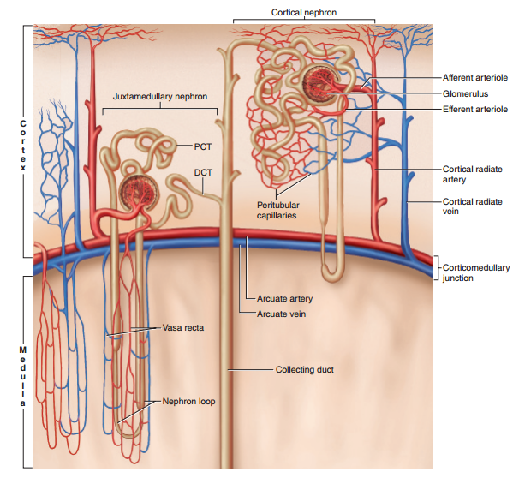
The kidney and the Glomerulus

Slide 18
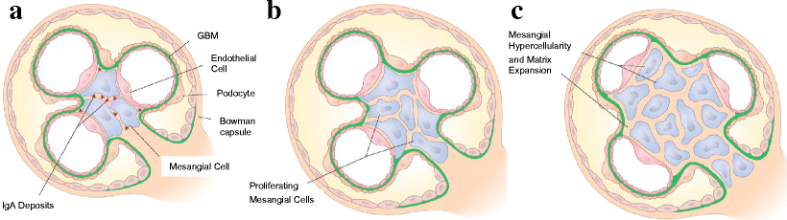
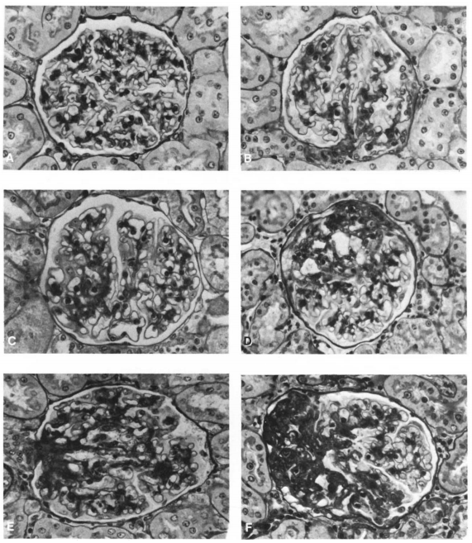
The Kidney and Glomerulus
4+
0
1+
2+
3+
Raji et al. 1984
4+

Slide 19
Hypothesis generation
Hypothesis 1:
There is a positive correlation between glomerular injury and blood pressure.
Hypothesis 2:
Distribution of glomerular injury throughout the kidney is not spatially random
-
Neighboring glomeruli are more likely to have the same injury score than you would expect to see from a random distribution.

Slide 20
A controlled study
Variables within the study included
Rat Strain (Heterogenous stock, Dahl salt-sensitive, and Sprague Dawley)
Kidney flushing protocols
Varying blood pressures of the animals due to experimental treatment (ranging from ~110 mmHg to ~180 mmHg)
How much data?
109 Kidneys were collected.
~32,000 glomeruli were imaged and assessed

Slide 21
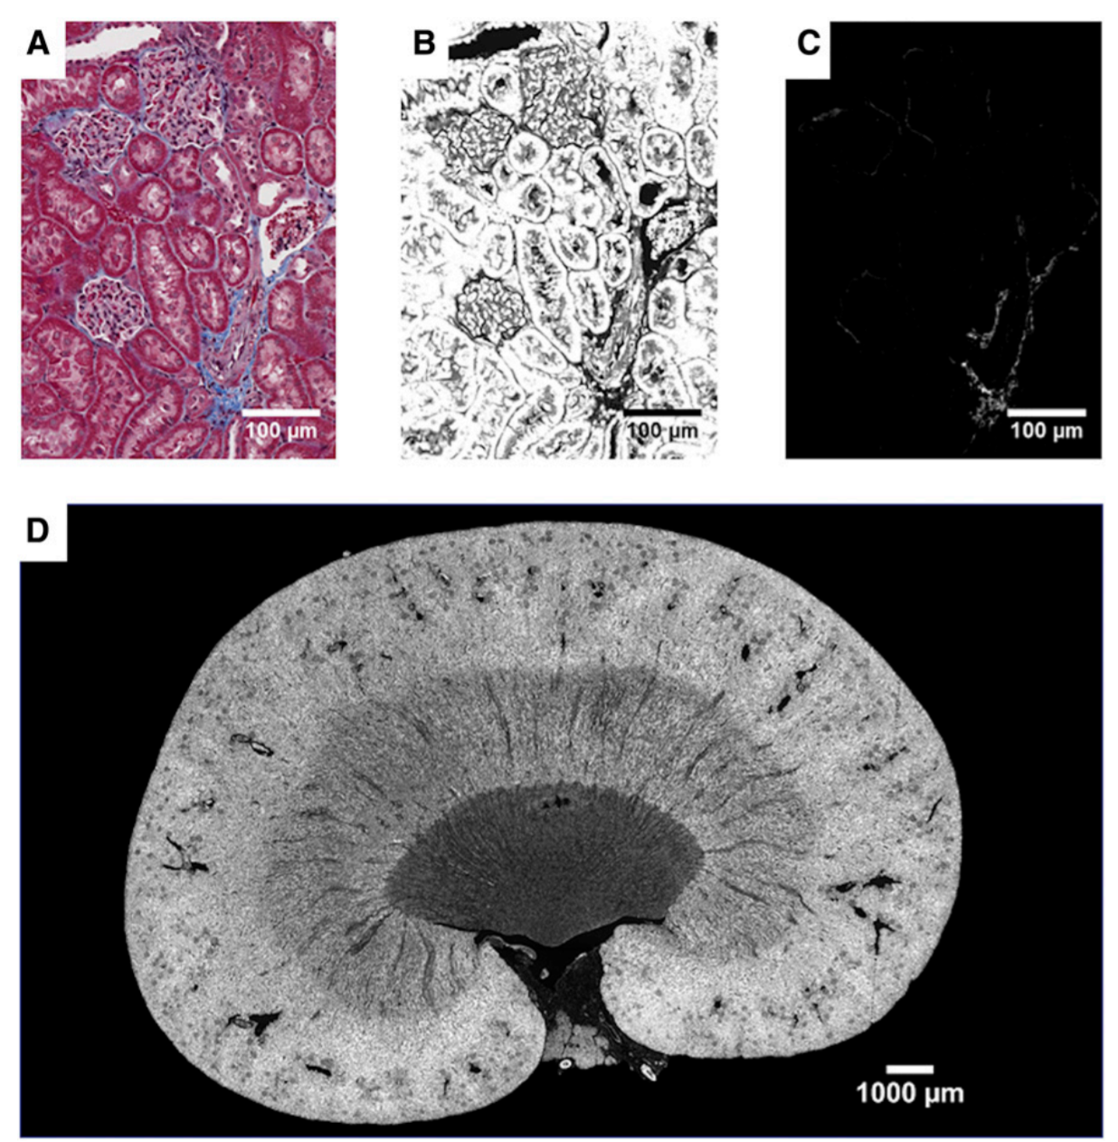
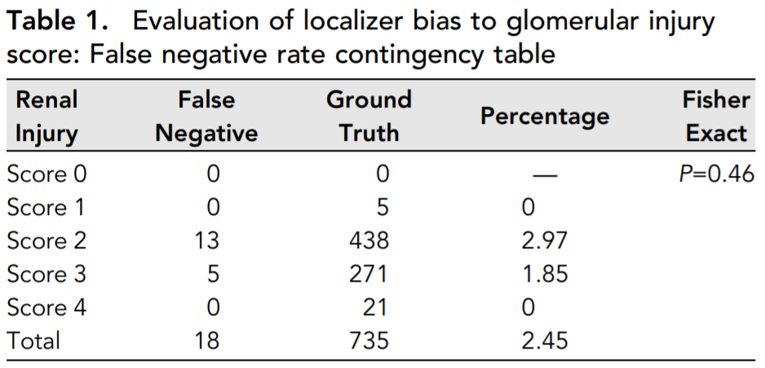
Sampling bias?

Slide 22
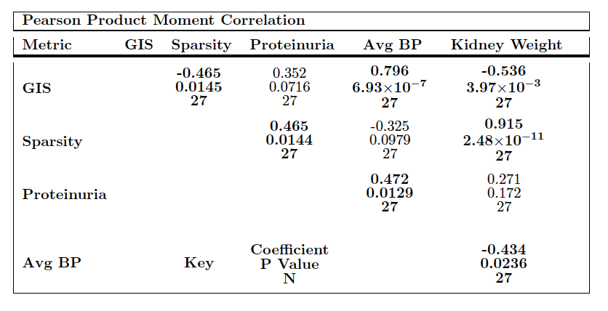
Hypothesis 1 – Sampling Bias
There is a positive correlation between glomerular injury and blood pressure.

Slide 23
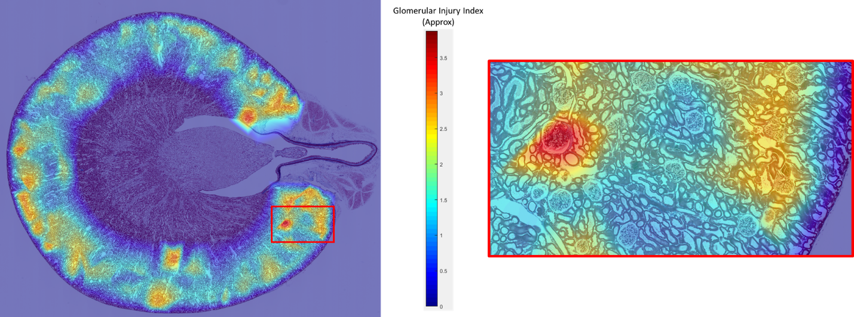
Hypothesis 2 – Spatial Distribution

Slide 24
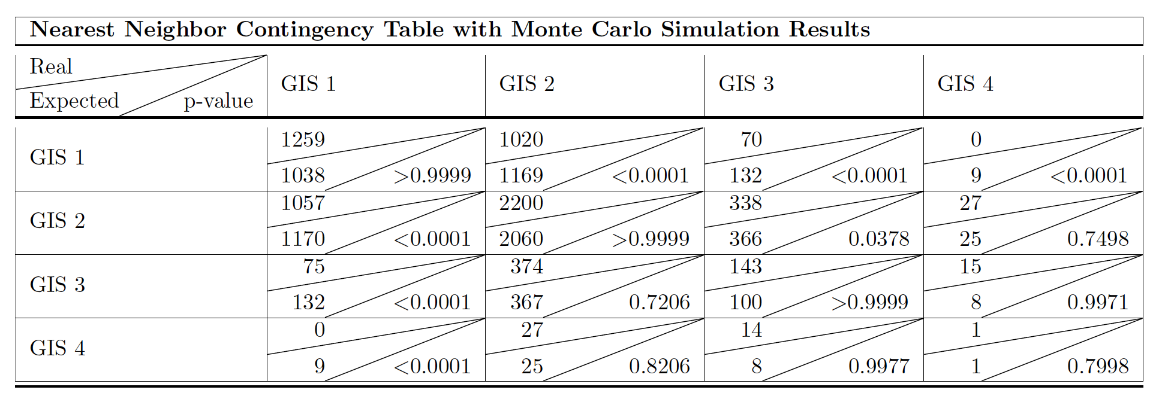
Hypothesis 2
Distribution of glomerular injury throughout the kidney is not spatially random
-
Neighboring glomeruli are more likely to have the same injury score than you would expect to see from a random distribution.

Slide 25
Additional Study Considerations

Slide 26
Ethical Considerations
Could the study impact someone's rights?
Could the study invade someone's privacy?
What will be the larger societal impact?
What will the subjects be hurt?
Do you have permission to use the data?

Slide 27
Data Privacy Laws
Health Insurance Portability and Accountability (HIPAA)
Family Educational Rights and Privacy Act (FERPA)
EU General Data Protection Regulation (GDPR)

Slide 28
Institutional Review Board
In medical and academic research situations, studies on humans or animal subjects need to be approved by an institutional review board (IRB)
The IRB will ask you to determine:
What data is being collected
Justify why that data is needed
Who will have access
Describe your plan for storage and use

Slide 29
Security
Risk Assessment
What is the expected cost of a breach vs value of the data?
What are the attack avenues?
Mitigating Risk
Only collect the data you absolutely need
Limit access to data
Limit how long you keep the data
Encryption (at rest / transfer)

